Slide 1
Team 2 Early Insights Presentation
Sophie Marugg, Daniel Celaj, Brian Li, Haiwei Sun
Sponsors: Councilor Louijeune and Jesse Purvis

Slide 2
Data Sets
Income-Restricted-Inventory-2021.csv
Boston_Zips.csv - original shapefile converted to as csv
msmda_14454.csv

Slide 3
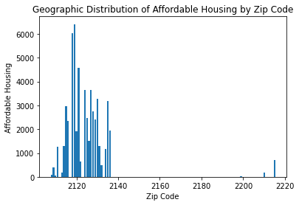
56,819 total units enrolled in affordable housing as of 2021
Notes:
So why does this matter? Our x axis isnt the most readable which will be changed going froward but I got this chart from reading in the csv and computing the number of income restricted units and comparing them by zipcode which led to this distribution with high spikes around roxbury and dorchester

Slide 4
Observations:
There is a geographic trend of where income restricted housing is vs where it isn’t based around supply and demand for tourist attractions or near colleges like BU, BC, NE
Roxbury has been in the news for their housing being 54% income- restricted housing
Most of the income restricted housing is south of Boston with the exception of Brighton.
Top 3 Neighborhoods with the most Section 8 Units
Roxbury 54
Dorchester 40
South End 22
Neighborhoods with Most Income Restricted Housing
Roxbury 10850
Dorchester 8607
South End 5408
Jamaica Plain 4001
Brighton 3412
Notes:
So on the left there are the top 3 neighborhoods with section 8 housing which is distinguished from income restricted housing. Then on the right we have the top 5 neighborhoods with the most income restricted housing available. Notably roxbury has the most and in november 2022 there was an article published by the boston globe about roxbury being 54% income restricted housing which i found to be relevant to distinguishing where and why these neighbrohoods have high rates of income restricted housing as opposed to other neighborhoods. All of the top5 except for brighton are all south of major attractions and colleges which is different you will see than areas with less income restricted housing.

Slide 5
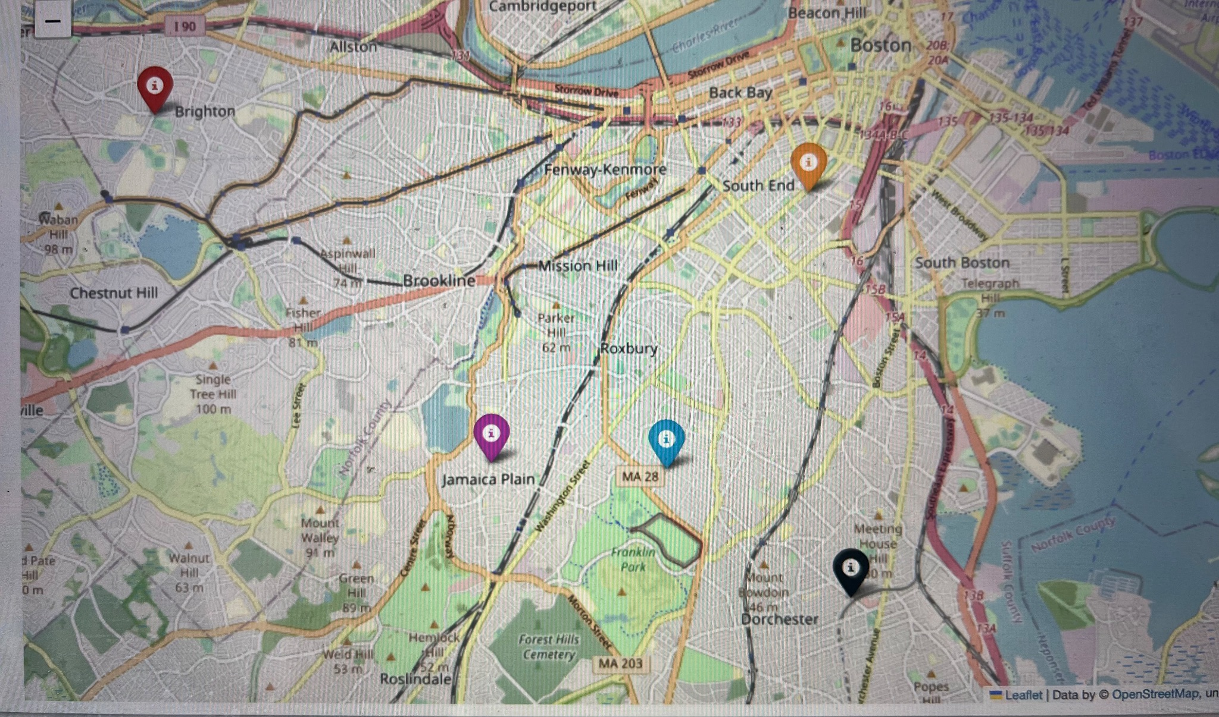
Neighborhoods with the most affordable housing
Blue = Roxbury
Black marker= Dorchester
Orange= South End
Purple = Jamaica Plain
Red marker = Brighton
Notes:
I made this folium map after researching the latitude and longitude of each neigbhorhood and you can see what i referenced earlier about all except brighton being south

Slide 6
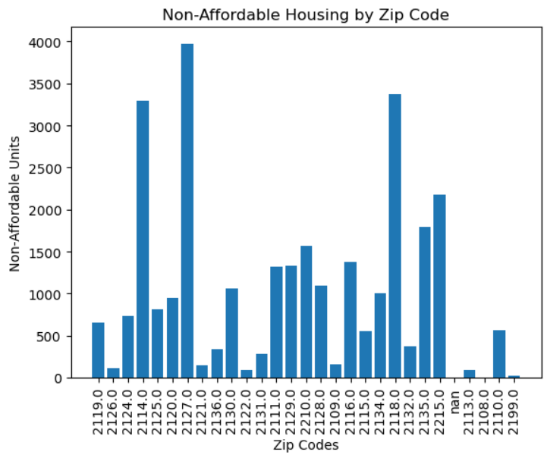
Number of units not enrolled in affordable housing as of 2021: 29,246
Notes:
The spike is the south boston waterfront

Slide 7
Units not offering Affordable Housing: 29,246
In Boston these are the neighborhoods with the least Income Restricted Housing Offered.
Top 5
South Boston Waterfront 4083
South End 3585
West End 2867
Fenway 2342
Brighton 1876
Observations:
Areas more localized to large colleges have far fewer income restricted housing options within the vicinity
Presumably because of the high demand and catering to a higher income population of students traveling in to go to these colleges
High demand
Central to “tourist” attractions such as Fenway, Seaport, etc..

Slide 8
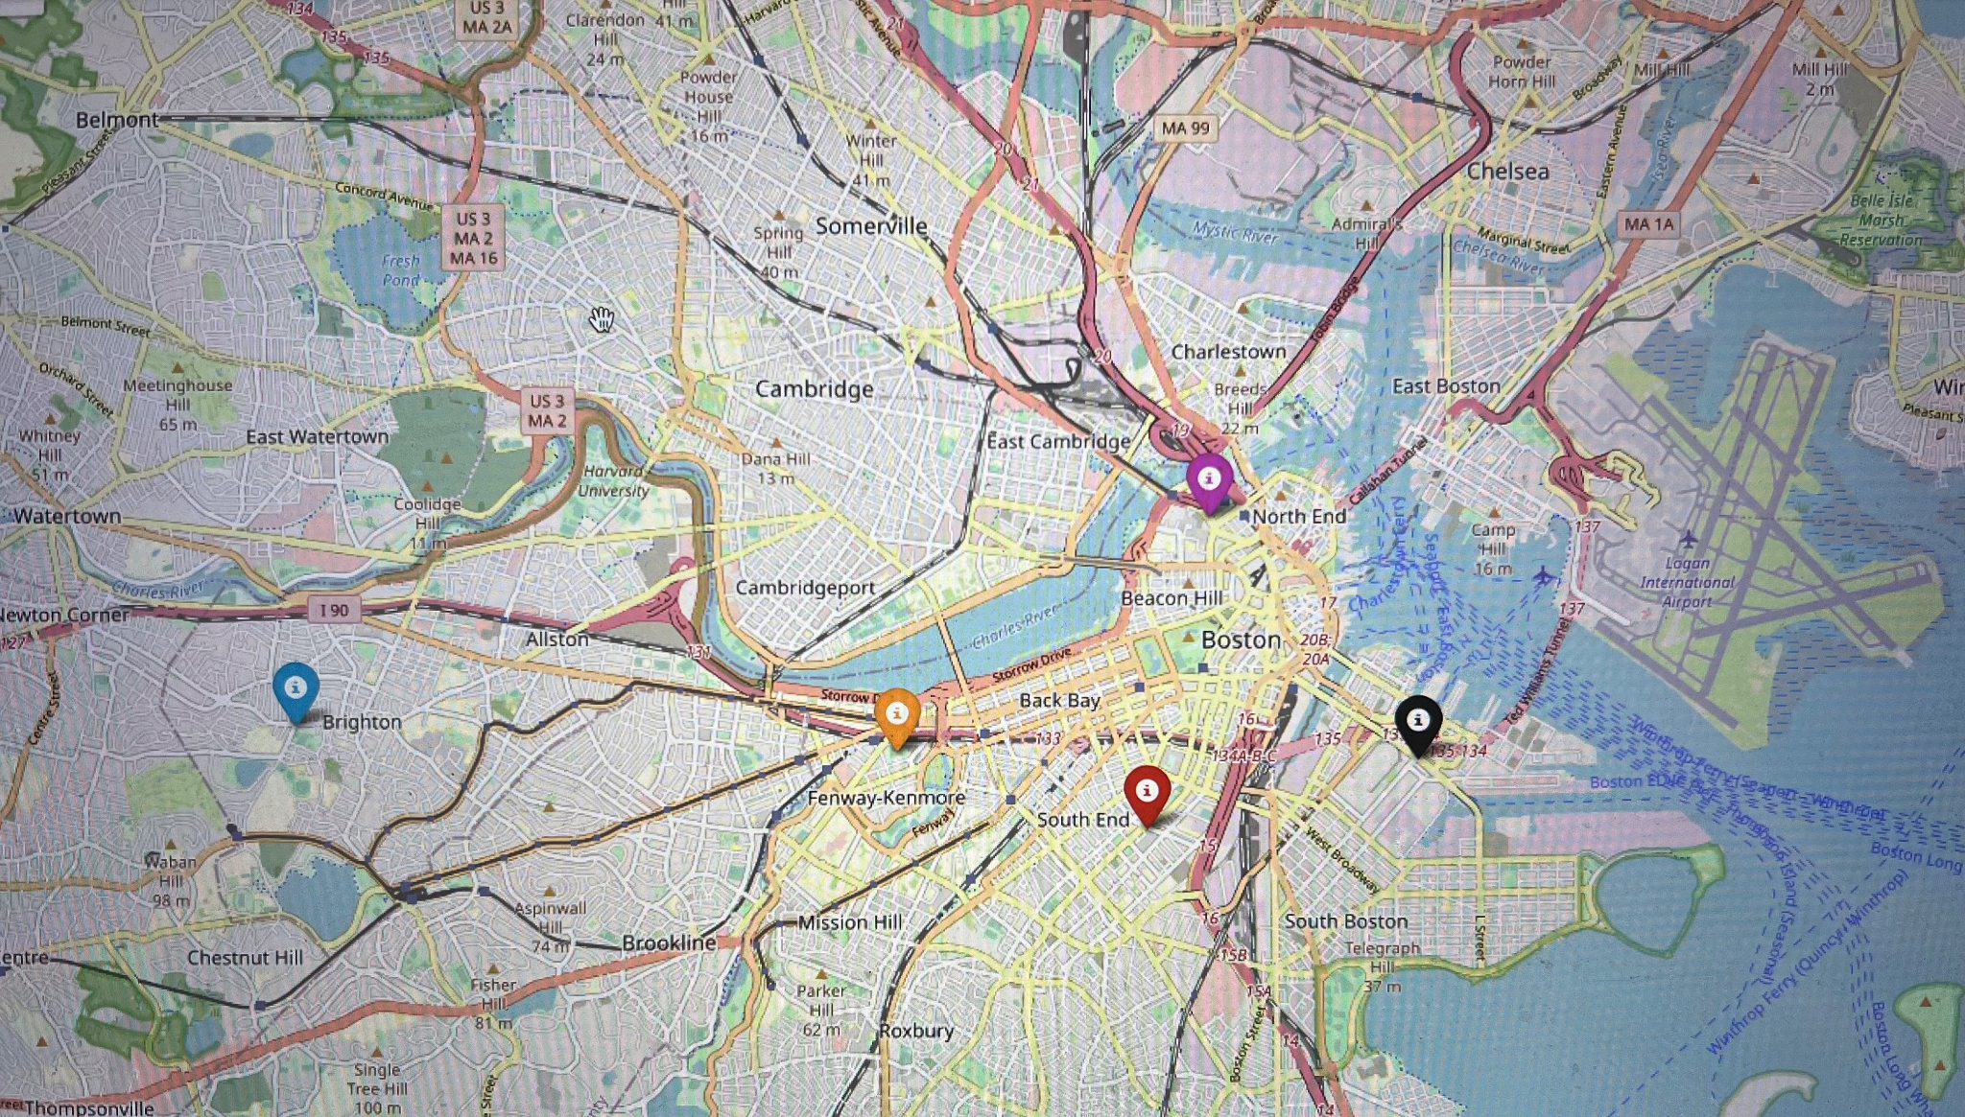
Neighborhoods with least affordable housing
Black marker= South Boston Waterfront
Red marker = South End
Purple = West End
Orange= Fenway
Blue = Brighton

Slide 9
Challenges
Finding the best data to answer our questions on the geographic distribution
Clearing NaN columns to make it usable from the larger data sets
Merging several data sets of income by neighborhood for future heatmap

Slide 10
Assumptions
Our csv that we primarily used was income-restricted-housing-2021.csv, but it did not explicitly say what the income threshold or technical definition of affordable total units meant in the scope of their data vs the total project units in the csv so we made the assumption based off of that. Our data is geared around the idea that when the csv for income-restricted-inventory references TtlProjUnits that it is the basis for all units and includes the affordable units.

Slide 11
Limitations
We didn’t have an exact number for the income threshold for what was required for the Total Income-Restricted to make more notable predictions
Where would we be potentially able to find information on this?

Slide 12
Based on the (early) results, what are the expected next steps?
Find more data specific to our extension proposal
Finish analyzing all the data for affordable housing before moving on to draw up specific, accurate results
We want to get data of zip code and income to be able to compare the 5 most and least income restricted housing
Expand our data to branch out from just income restricted housing

Slide 13
Extension Proposal
Extension Pitch
We are interested in looking at the history of redlining in Boston and comparing to mortgage rates of areas where loans are being approved or rejected. Since we have made progress of income restricted housing and not income restricted housing, narrowing down percentages, and seeing loan approval/amount rates.
Rationale
This is an exceptionally important aspect to acknowledge and with the historical context of gerrymandering and redlining we would be able to determine whether or not these areas are still being impacted by discrimination. It also would highlight whether these areas with income restricted housing are lower income or if it biased based off of more residential properties.
Questions for Analysis
We hope to find whether or not redlining is the basis of discrimination in modern day mortgage lending, and if it is then where it is having an effect on/ who/ if there are trends of discrimination. Also seeing where these residential areas are approved.
.
Data Sets & Sources
Include the dataset(s) you will be using and any additional information that will be used directly in the extension
https://www.arcgis.com/home/item.html?id=263b64f4edf04a589d675d97964f1bea // redlining updates through boston
https://dataverse.harvard.edu/dataset.xhtml?persistentId=doi:10.7910/DVN/WXZ1XK // redlining in boston history
https://financialequity.net/building-commonwealth/ // financial disbursement in MA

Slide 14
Slide 2 - Haiwei
What have you done so far? (meetings, data analysis)
We have had a meeting with the client for what we need to do in the first part and the size of data we need to use. In addition, we have private meetings both online and in person. For data analysis, we use the data of HMDA dataset and income-restricted-inventory-2021.csv for the questions of affordable housing and landlord distribution.
How did you divide up the work among the team?
For the part before deliverable 1, Sophie for the part of affordable housing, Brian for the part of distribution of landlords, Haiwei for the part of .analyzing the loans.
What data have you used? If you collected data, how did you do that?
We have used the two csv files called msamd_14454.csv and income-restricted-inventory-2021.csv and an excel form called TRACT_ZIP_122021.xlsx. We count the distribution of loans, and plot the picture of the loan distribution group by zipcode and home loan distribution group by district.
For the presentation roles for Deliverable 2: Brian did the first slide, Haiwei did this slide, Daniel made slide 3, Sophie made the rest

Slide 15
Slide 1
Project Motivation
We want to see if there is discrimination of in lending/banking for individuals who are seeking home ownership at the neighborhood level by examining who is participating in first time home ownership and who are receiving loans and purchasing homes
Project goals
To investigate if there is discrimination. Find patterns in the participation of first time home ownership. Identify any differences in lending and home ownership
Background
We have analyzed data sources to find the geographical distribution of affordable housing in Boston
Project Title, Sponsor, Team Members - Fair Housing Discrimination, Ruthzee Louijuene, Sophie Marugg, Daniel Celaj, Brian Li, Haiwei Sun

